Slide 1
DEFECT REPORT

Slide 2
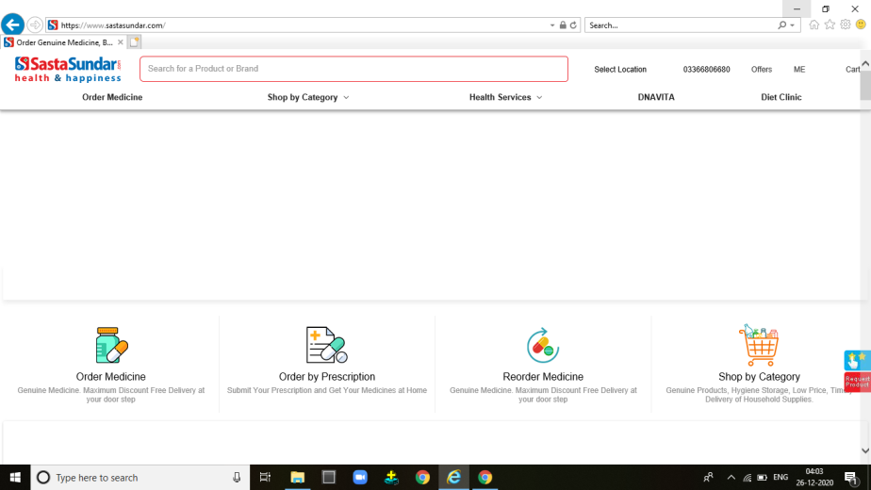
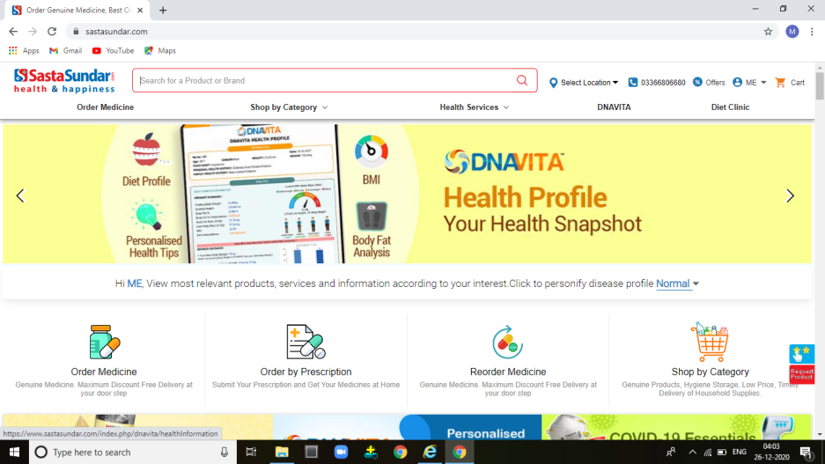
REPORT NO 1
1.ENTER THE URL IN DIFFERENT BROWSER LIKE CHROME,INTERNET EXPLORER
2.CLICK SASTA SUNDAR LINK IN BROWSER
3.IT DISPLAY SAME IN BOTH THE BROWSER
EXPECTED RESULT | ACTUAL RESULT | STATUS
IT DISPLAY PROPERLY IN BOTH THE BROWERS | IT NOT DISPLAY PROPERLY IN INTERNET EXPLORER BROWSER 1.IN CHROME BROWSER IT SHOWS ADVERTISMENT 2.IN INTERNET EXPLORER IN DOESNOT SHOW THE ADVERTISMENT | FAIL
INTERNET EXPLORER
CHROME

Slide 3
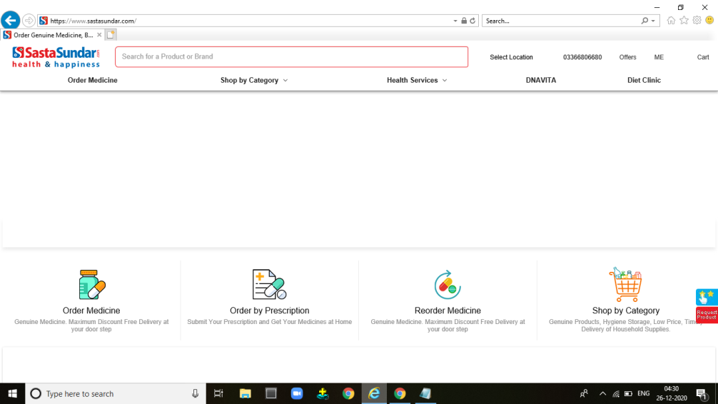
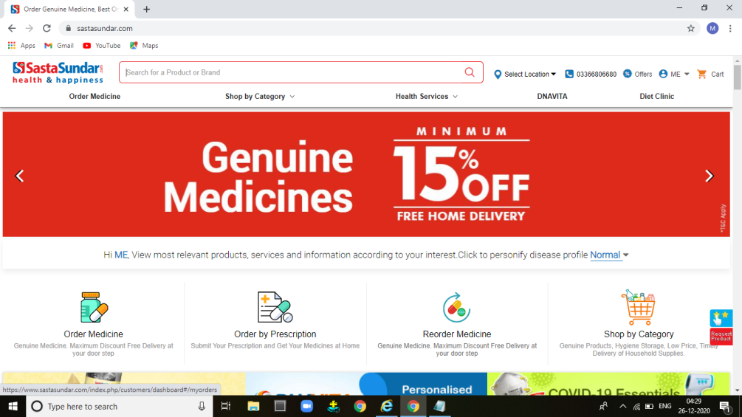
REPORT NO 2
1.ENTER THE URL IN DIFFERENT BROWSER LIKE CHROME,INTERNET EXPLORER
2.CLICK SASTA SUNDAR LINK IN BROWSER
3.IT DISPLAY SAME IN BOTH THE BROWSER
EXPECTED RESULT | ACTUAL RESULT | STATUS
IT DISPLAY OBJECT ICONS IN BOTH THE BROWERS | IT NOT DISPLAY PROPERLY IN INTERNET EXPLORER BROWSER 1.IN CHROME BROWSER IT SHOWS OBJECT ICONS 2.IN INTERNET EXPLORER IN DOESNOT SHOW OBJECT ICONS | FAIL
INTERNET EXPLORER
CHROME

Slide 4
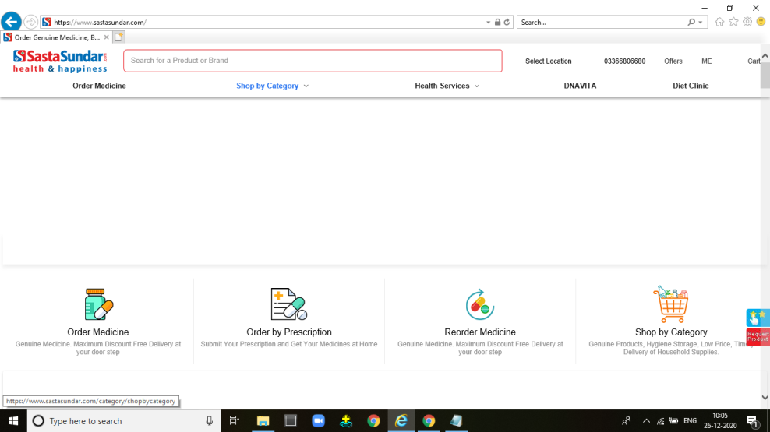
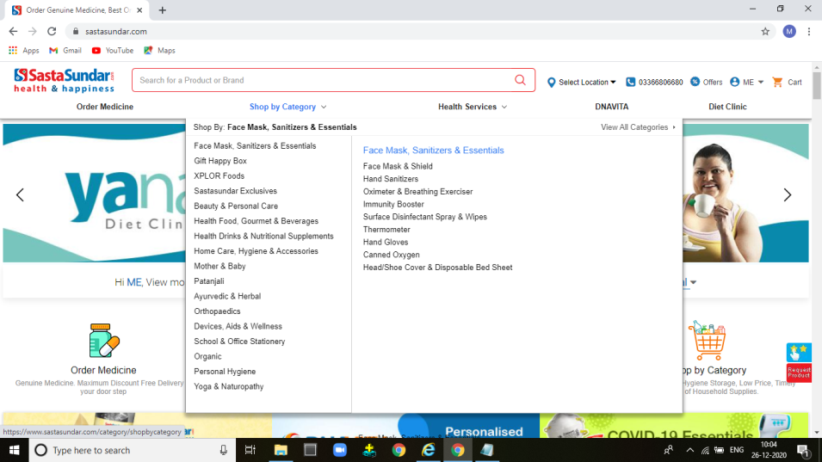
REPORT NO 3
1.ENTER THE URL IN DIFFERENT BROWSER LIKE CHROME,INTERNET EXPLORER
2.CLICK SASTA SUNDAR LINK IN BROWSER
3.IN HOME PAGE GOTO SHOP BY CATEGORY OBJECT
EXPECTED RESULT | ACTUAL RESULT | STATUS
IT DISPLAY DROPDOWN MENU IN BOTH THE BROWERS | IT NOT DISPLAY PROPERLY IN INTERNET EXPLORER BROWSER 1.IN CHROME BROWSER DROPDOWN IS DISPLAYED 2.IN INTERNET EXPLORER THE DROPDOWN NOT DISPLAY | FAIL
INTERNET EXPLORER
CHROME

Slide 5
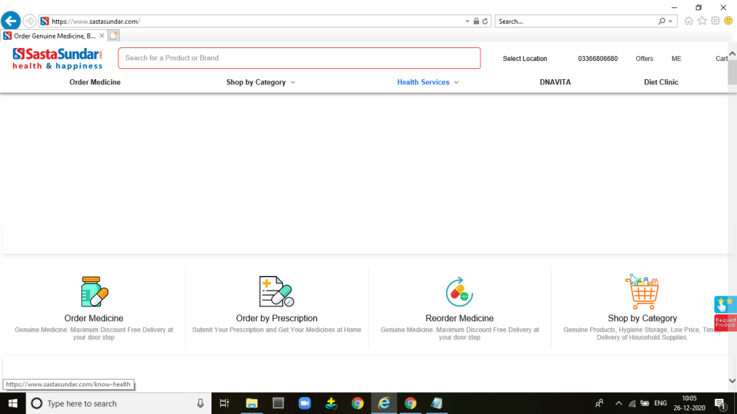
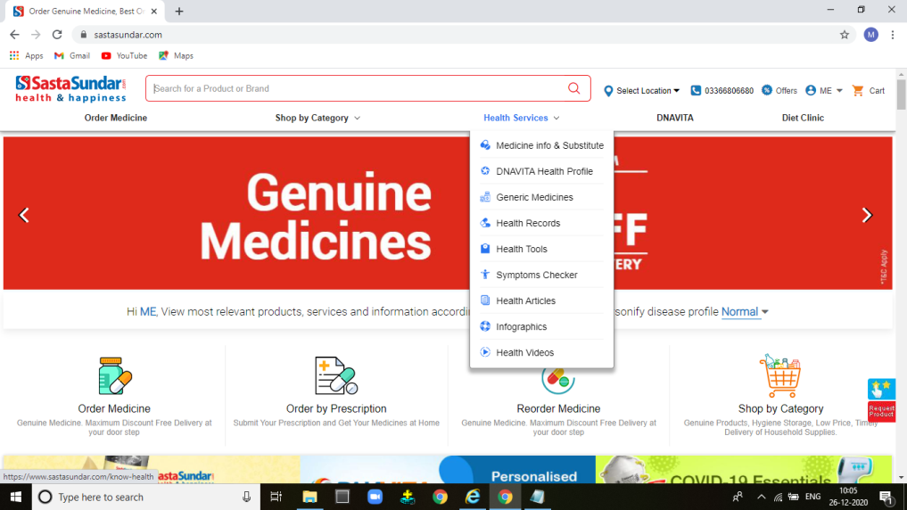
REPORT NO 4
1.ENTER THE URL IN DIFFERENT BROWSER LIKE CHROME,INTERNET EXPLORER
2.CLICK SASTA SUNDAR LINK IN BROWSER
3.IN HOME PAGE GOTO HEALTH SERVICES OBJECT
EXPECTED RESULT | ACTUAL RESULT | STATUS
IT DISPLAY DROPDOWN MENU IN BOTH THE BROWERS | IT NOT DISPLAY PROPERLY IN INTERNET EXPLORER BROWSER 1.IN CHROME BROWSER DROPDOWN IS DISPLAYED 2.IN INTERNET EXPLORER THE DROPDOWN NOT DISPLAY | FAIL
INTERNET EXPLORER
CHROME

Slide 6
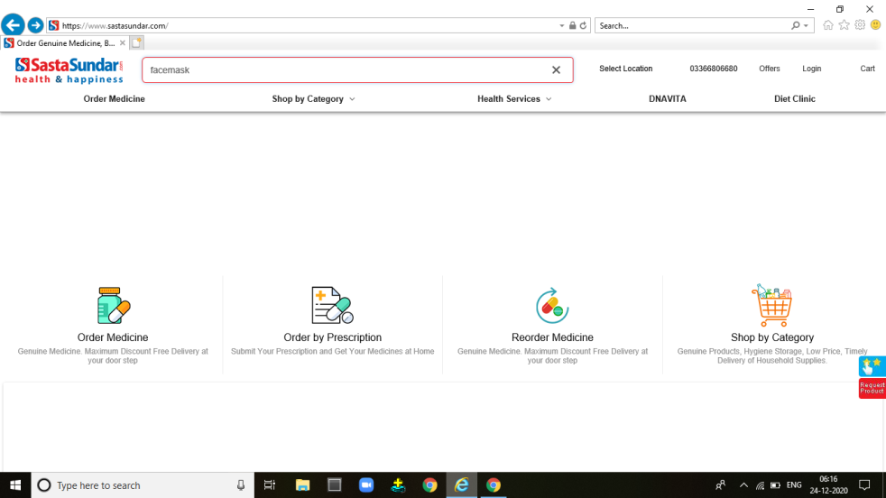
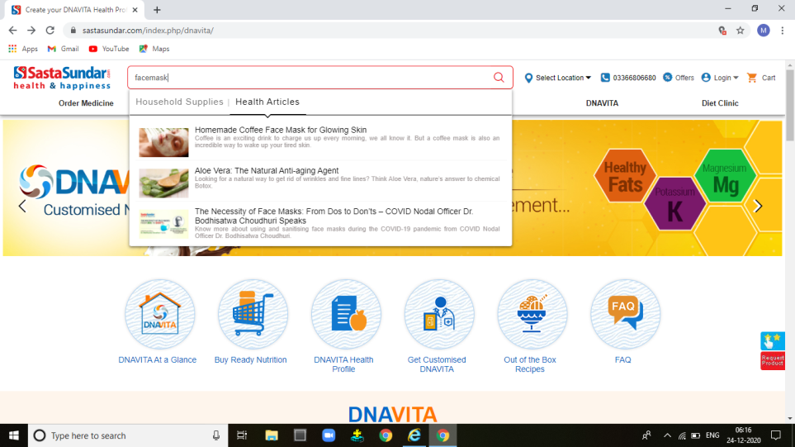
REPORT NO 5
1.ENTER THE URL IN DIFFERENT BROWSER LIKE CHROME,INTERNET EXPLORER
2.CLICK SASTA SUNDAR LINK IN BROWSER
3.IN HOME PAGE GOTO SEARCH OPTION
4.TYPE ANY PRODUCT NAME
EXPECTED RESULT | ACTUAL RESULT | STATUS
IT DISPLAY DROPDOWN DETAILS OF PRODUCT IN BOTH THE BROWERS | IT NOT DISPLAY PROPERLY IN INTERNET EXPLORER BROWSER 1.IN CHROME BROWSER DROPDOWN DETAILS OF PRODUCT IS DISPLAYED 2.IN INTERNET EXPLORER THE DROPDOWN DETAILS NOT DISPLAY | FAIL
INTERNET EXPLORER
CHROME

Slide 7


REPORT NO 6
1.ENTER THE URL IN DIFFERENT BROWSER LIKE CHROME,INTERNET EXPLORER
2.CLICK SASTA SUNDAR LINK IN BROWSER
3.IN HOME PAGE GOTO SEARCH OPTION
4.TYPE ANY PRODUCT NAME
EXPECTED RESULT | ACTUAL RESULT | STATUS
IT DISPLAY SEARCH OPTION IN BOTH THE BROWERS | IT NOT DISPLAY PROPERLY IN INTERNET EXPLORER BROWSER 1.IN CHROME BROWSER SEARCH OPTION IS DISPLAYED 2.IN INTERNET EXPLORER SEARCH OPTION NOT DISPLAY | FAIL
INTERNET EXPLORER
CHROME

Slide 8
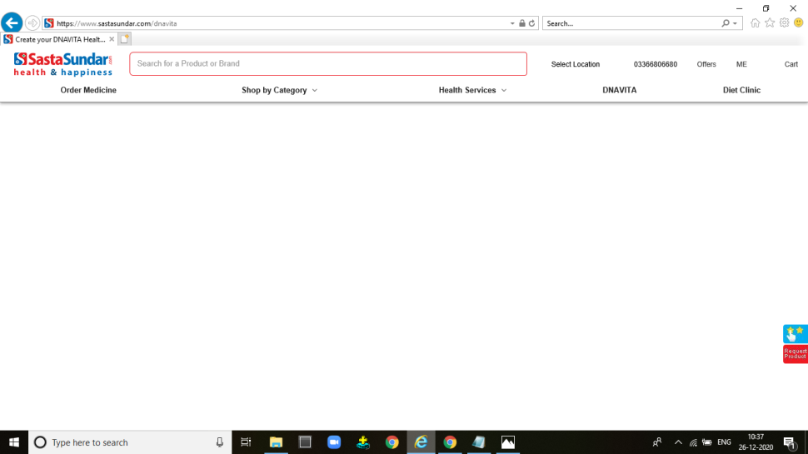
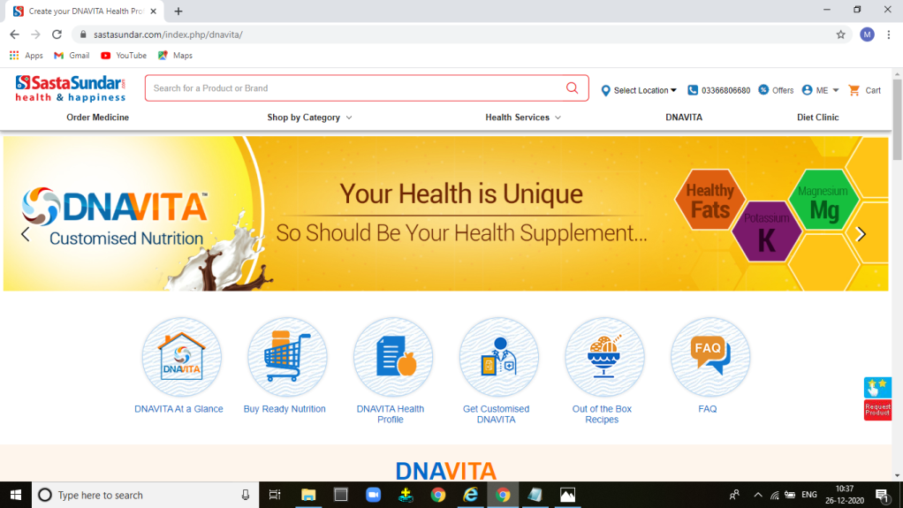
REPORT NO 7
1.ENTER THE URL IN DIFFERENT BROWSER LIKE CHROME,INTERNET EXPLORER
2.CLICK SASTA SUNDAR LINK IN BROWSER
3. IN HOME PAGE CLICK DNAVITA FEATURE
EXPECTED RESULT | ACTUAL RESULT | STATUS
THE DNAVITA SHOULD BE DISPLAY IN BOTH THE BROWERS | IT NOT DISPLAY PROPERLY IN INTERNET EXPLORER BROWSER 1.IN CHROME BROWSER DNAVITA PAGE IS DISPLAYED 2.IN INTERNET EXPLORER DNAVITA PAGE IS NOT DISPLAY | FAIL
INTERNET EXPLORER
CHROME

Slide 9
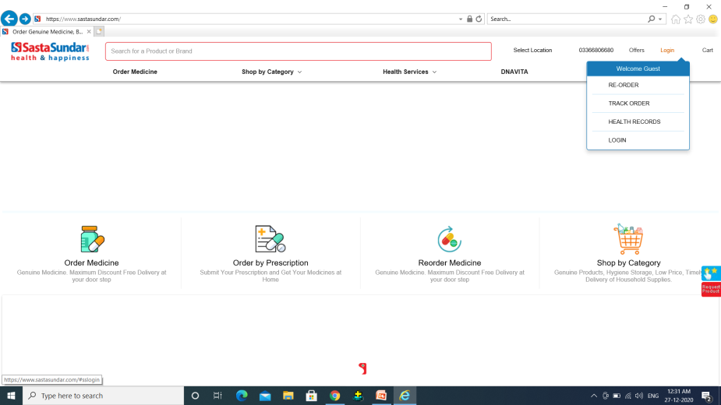
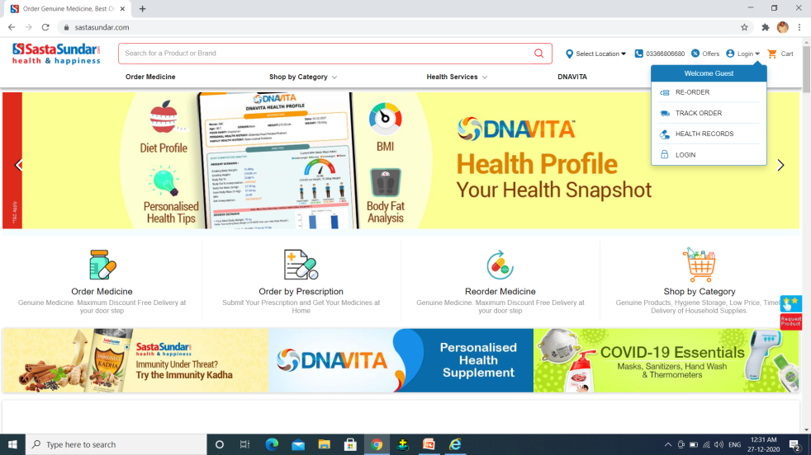
REPORT NO 8
1.ENTER THE URL IN DIFFERENT BROWSER LIKE CHROME,INTERNET EXPLORER
2.CLICK SASTA SUNDAR LINK IN BROWSER
3. IN HOME PAGE GOTO LOGIN FEATURE
EXPECTED RESULT | ACTUAL RESULT | STATUS
THE LOGIN FEATURE ICONS SHOULD BE DISPLAY IN BOTH THE BROWERS | IT NOT DISPLAY PROPERLY IN INTERNET EXPLORER BROWSER 1.IN CHROME BROWSER LOGIN FEATURE ICONS IS DISPLAYED 2.IN INTERNET EXPLORER LOGIN ICON FEATURE IS NOT DISPLAY | FAIL
INTERNET EXPLORER
CHROME

Slide 10
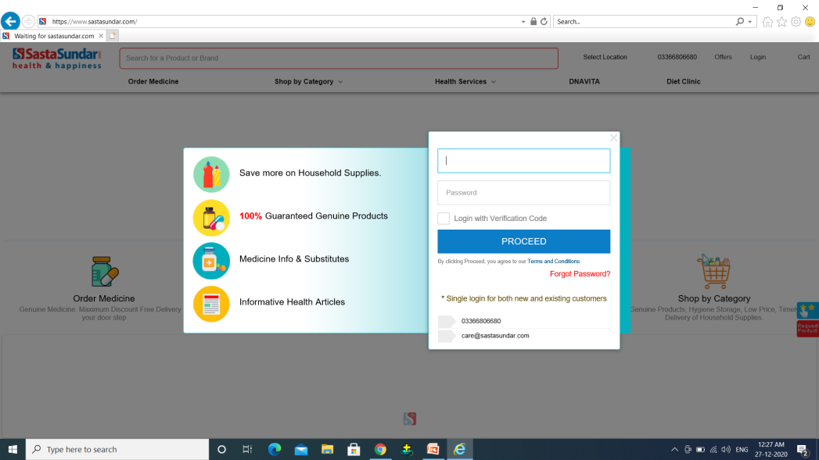
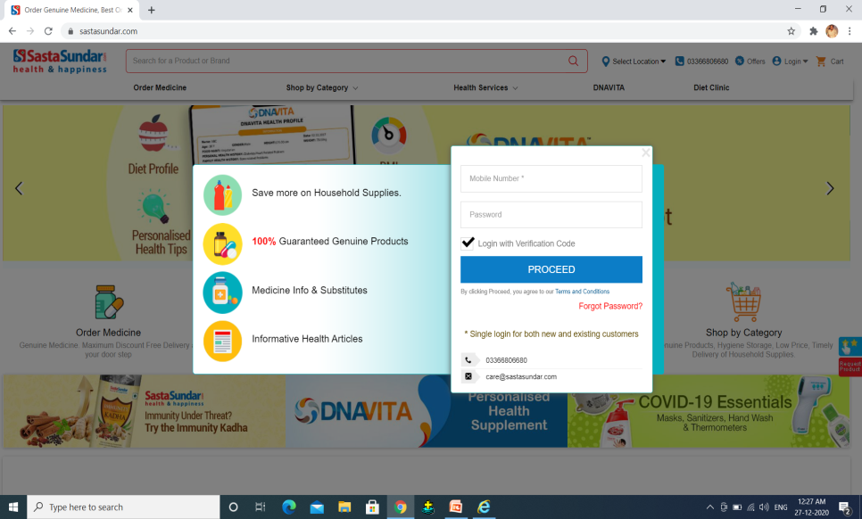
REPORT NO 9
1.ENTER THE URL IN DIFFERENT BROWSER LIKE CHROME,INTERNET EXPLORER
2.CLICK SASTA SUNDAR LINK IN BROWSER
3. IN HOME PAGE CLICK LOGIN BUTTON
EXPECTED RESULT | ACTUAL RESULT | STATUS
THE LOGIN PAGE SHOULD BE DISPLAY IN BOTH THE BROWERS AND LOGIN WITH VERIFICATION CODE CHECK BOX AUTOMATICALLY SELECTED | IT NOT DISPLAY PROPERLY WORK IN INTERNET EXPLORER BROWSER 1.IN CHROME BROWSER LOGIN PAGE WITH AUTOMATICALLY SELECT CHECK BOX IS DISPLAYED 2.IN INTERNET EXPLORER LOGIN PAGE IS DISPLAY BUT CHECK BOX IS NOT SELECTED AND ITS NOT SELECTED | FAIL
INTERNET EXPLORER
CHROME

Slide 11
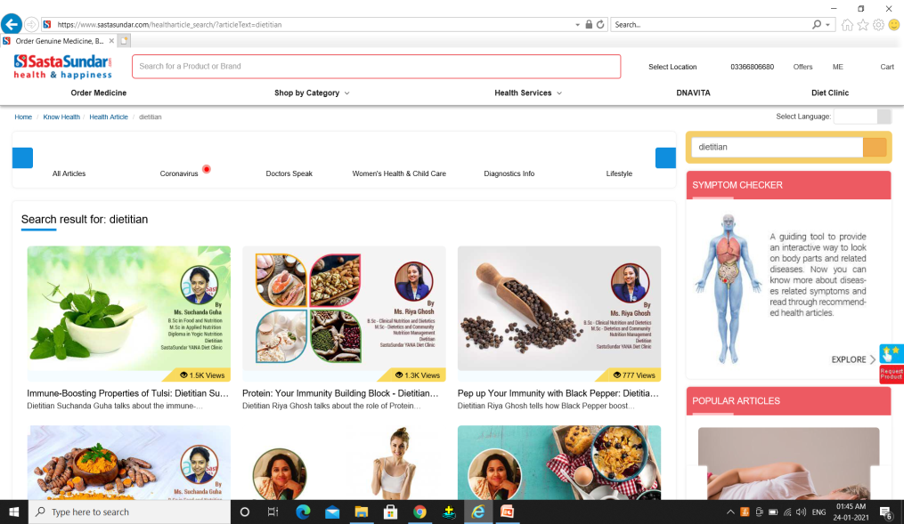
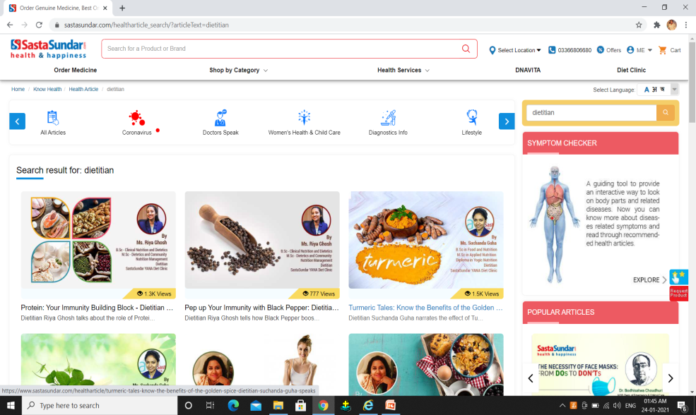
REPORT NO 10
1.ENTER THE URL IN DIFFERENT BROWSER LIKE CHROME,INTERNET EXPLORER
2.CLICK SASTA SUNDAR LINK IN BROWSER
3. IN HOME PAGE CLICK DIET CLINIC IN BOTH THE BROWSERS
4.IN DIET CLINIC PAGE CLICK ON HEALTH ARTICLES LINK
EXPECTED RESULT | ACTUAL RESULT | STATUS
HEALTH ARTICLE PAGE SHOULD BE DISPLAY PROPERLY | IT IS NOT PROPERLY WORKING THE INTERNET EXPLORER 1.THE FEATURES ICON IMAGES IS DISPLAYED 2.THE FEATURES ICONS IS NOT DISPLAYED | FAIL
INTERNET EXPLORER
CHROME

Slide 12
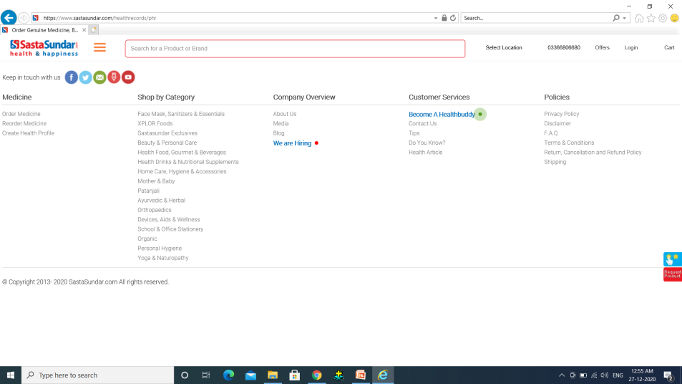
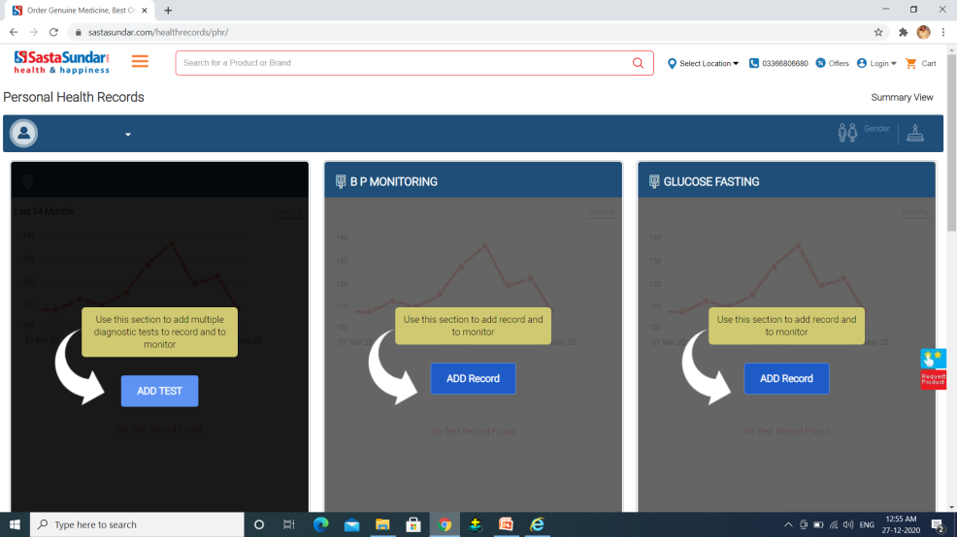
REPORT NO 11
1.ENTER THE URL IN DIFFERENT BROWSER LIKE CHROME,INTERNET EXPLORER
2.CLICK SASTA SUNDAR LINK IN BROWSER
3. IN HOME PAGE GOTO LOGIN FEATURE AND CLICK HEALTH RECORDS LINK
EXPECTED RESULT | ACTUAL RESULT | STATUS
THE HEALTH RECORDS PAGE SHOULD BE DISPLAY IN BOTH THE BROWERS | IT NOT DISPLAY PROPERLY IN INTERNET EXPLORER BROWSER 1.IN CHROME BROWSER HEALTH RECORDS PAGE IS DISPLAYED 2.IN INTERNET EXPLORER HEALTH RECORDS PAGE IS NOT DISPLAY | FAIL
INTERNET EXPLORER
CHROME

Slide 13
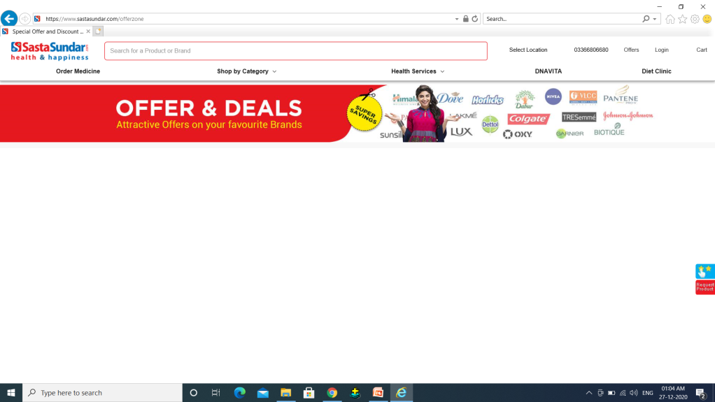
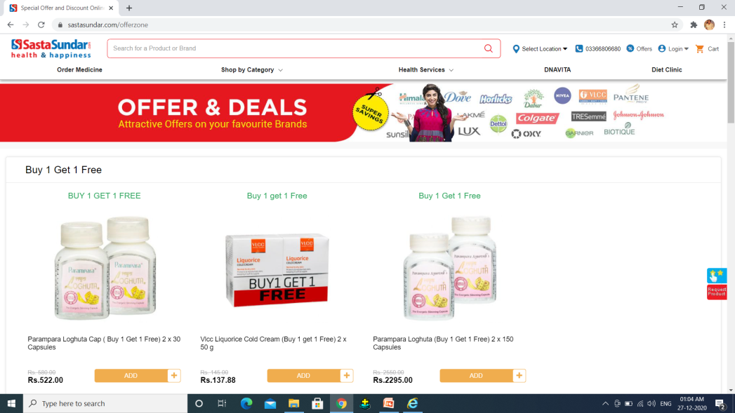
REPORT NO 12
1.ENTER THE URL IN DIFFERENT BROWSER LIKE CHROME,INTERNET EXPLORER
2.CLICK SASTA SUNDAR LINK IN BROWSER
3. IN HOME PAGE CLICK OFFERS FEATURE LINK
EXPECTED RESULT | ACTUAL RESULT | STATUS
THE OFFERS PAGE SHOULD BE DISPLAY IN BOTH THE BROWERS | IT NOT DISPLAY PROPERLY IN INTERNET EXPLORER BROWSER 1.IN CHROME BROWSER OFFERS PAGE IS DISPLAYED 2.IN INTERNET EXPLORER OFFERS PAGE NOT PROPERLY DISPLAY | FAIL
INTERNET EXPLORER
CHROME

Slide 14
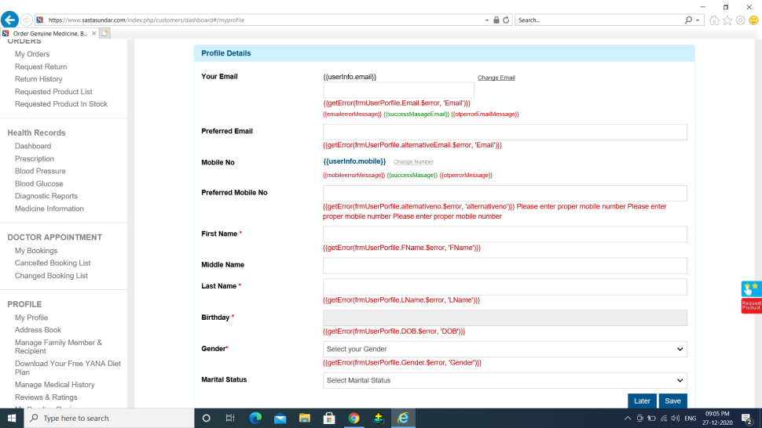
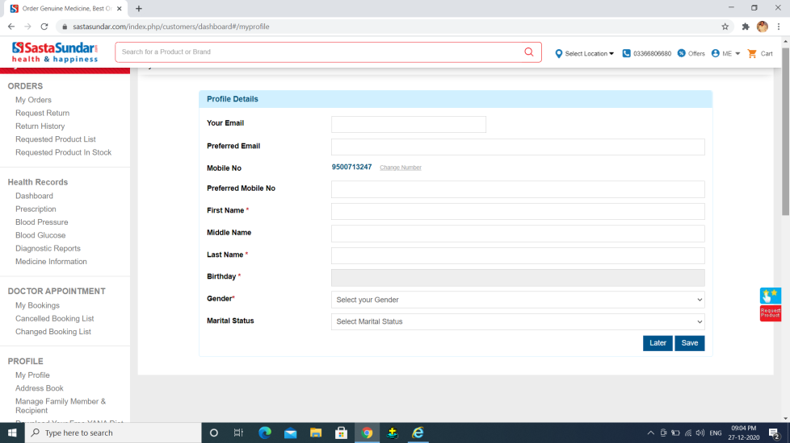
REPORT NO 13
1.ENTER THE URL IN DIFFERENT BROWSER LIKE CHROME,INTERNET EXPLORER
2.CLICK SASTA SUNDAR LINK IN BROWSER
3. IN HOME PAGE LOGIN AS USER A IN BOTH THE BROWSERS
4.CLICK MY PROFILE LINK
EXPECTED RESULT | ACTUAL RESULT | STATUS
THE MY PROFILE PAGE SHOULD BE DISPLAY PROPERLY IN BOTH THE BROWERS | IT NOT DISPLAY PROPERLY IN INTERNET EXPLORER BROWSER 1.IN CHROME BROWSER MY PROFILE PAGE IS DISPLAYED 2.IN INTERNET EXPLORER MY PROFILE PAGE NOT PROPERLY DISPLAY | FAIL
INTERNET EXPLORER
CHROME

Slide 15
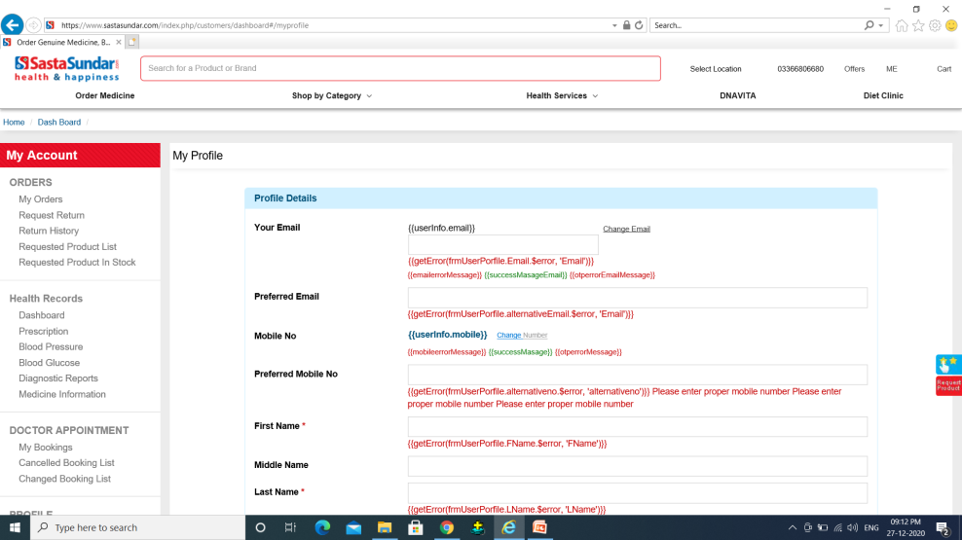
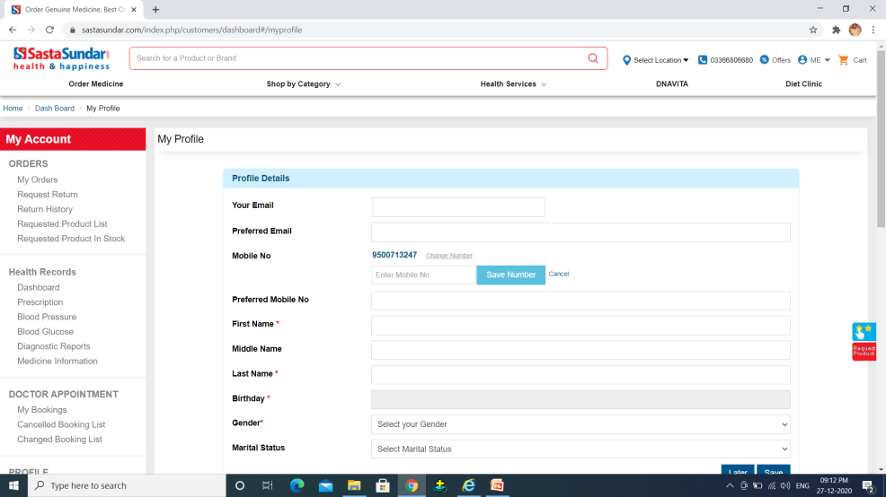
REPORT NO 14
1.ENTER THE URL IN DIFFERENT BROWSER LIKE CHROME,INTERNET EXPLORER
2.CLICK SASTA SUNDAR LINK IN BROWSER
3. IN HOME PAGE LOGIN AS USER A IN BOTH THE BROWSERS
4.CLICK MY PROFILE LINK
EXPECTED RESULT | ACTUAL RESULT | STATUS
IN MY PROFILE PAGE CHANGE PHONE NUMBER SHOULD BE WORK IN BOTH THE BROWSER | IT NOT DISPLAY PROPERLY IN INTERNET EXPLORER BROWSER 1.IN CHROME BROWSER MY PROFILE PAGE CHANGE NUMBER OPTION IS WORKED 2.IN INTERNET EXPLORER MY PROFILE CHANGE NUMBER OPTION NOT WORK AND NOT DISPLAY | FAIL
INTERNET EXPLORER
CHROME

Slide 16
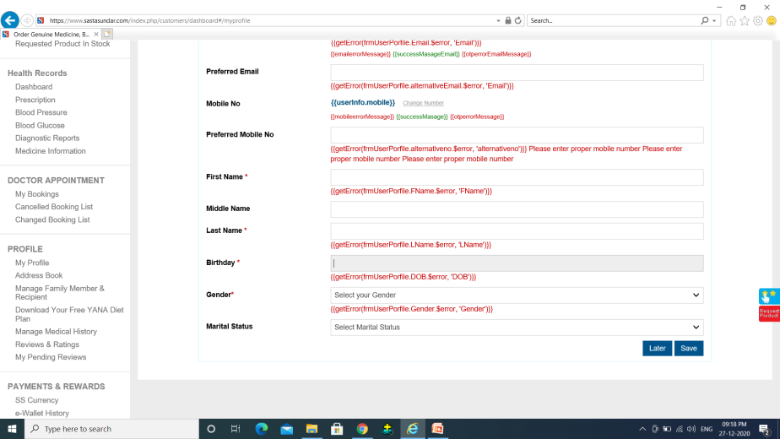
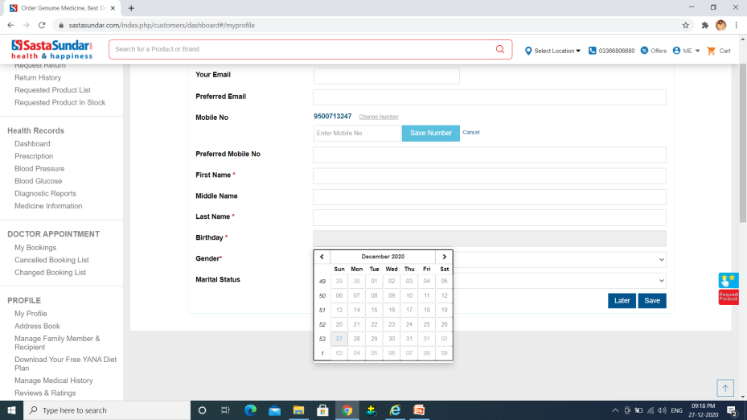
REPORT NO 15
1.ENTER THE URL IN DIFFERENT BROWSER LIKE CHROME,INTERNET EXPLORER
2.CLICK SASTA SUNDAR LINK IN BROWSER
3. IN HOME PAGE LOGIN AS USER A IN BOTH THE BROWSERS
4.CLICK MY PROFILE LINK
EXPECTED RESULT | ACTUAL RESULT | STATUS
IN MY PROFILE PAGE BIRTHDAY OPTION SHOULD BE WORK IN BOTH THE BROWSER | IT NOT DISPLAY PROPERLY IN INTERNET EXPLORER BROWSER 1.IN CHROME BROWSER MY PROFILE PAGE BIRTHDAY OPTION IS WORKED AND CALENDER WILL BE DISPLAY 2.IN INTERNET EXPLORER MY PROFILE BIRTHDAY OPTION NOT WORK AND CALENDER IS NOT DISPLAY
INTERNET EXPLORER
CHROME

Slide 17
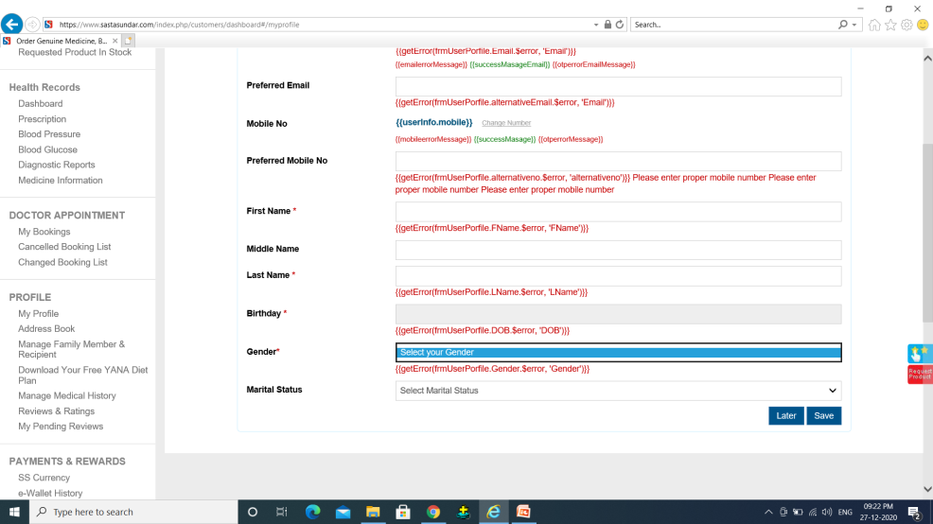
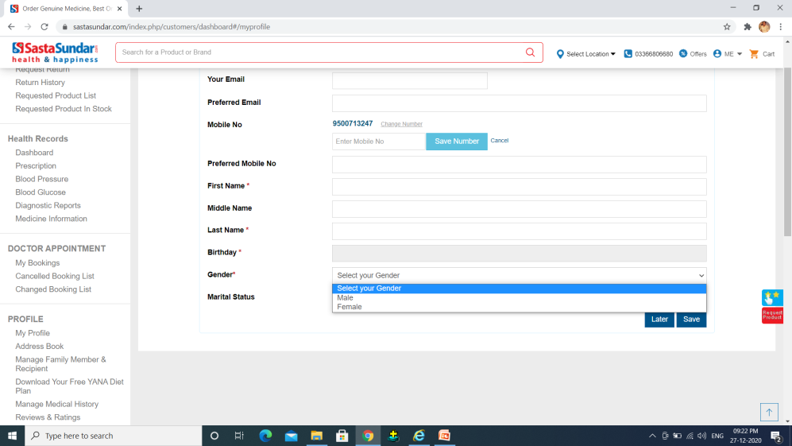
REPORT NO 16
1.ENTER THE URL IN DIFFERENT BROWSER LIKE CHROME,INTERNET EXPLORER
2.CLICK SASTA SUNDAR LINK IN BROWSER
3. IN HOME PAGE LOGIN AS USER A IN BOTH THE BROWSERS
4.CLICK MY PROFILE LINK
EXPECTED RESULT | ACTUAL RESULT | STATUS
IN MY PROFILE PAGE GENDER OPTION SHOULD BE WORK IN BOTH THE BROWSER | IT NOT DISPLAY PROPERLY IN INTERNET EXPLORER BROWSER 1.IN CHROME BROWSER MY PROFILE PAGE GENDER OPTION IS WORKED AND DROPDOWN WILL BE DISPLAY 2.IN INTERNET EXPLORER MY PROFILE GENDER OPTION NOT WORK AND DROPDOWN IS NOT DISPLAY | FAIL
INTERNET EXPLORER
CHROME

Slide 18
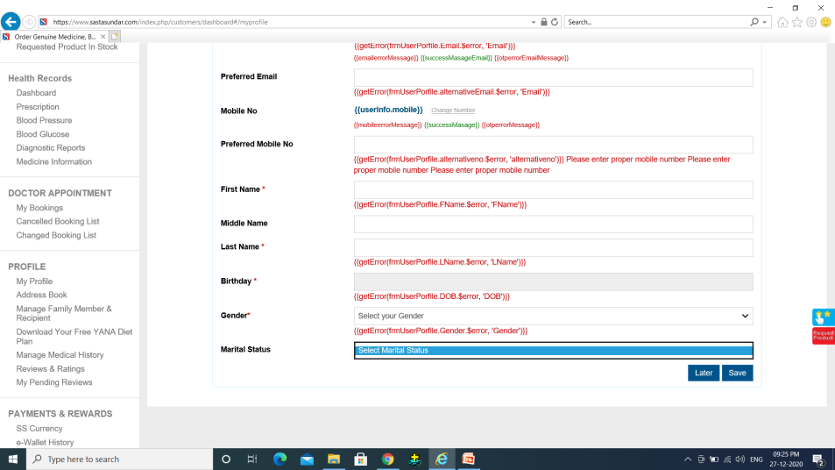
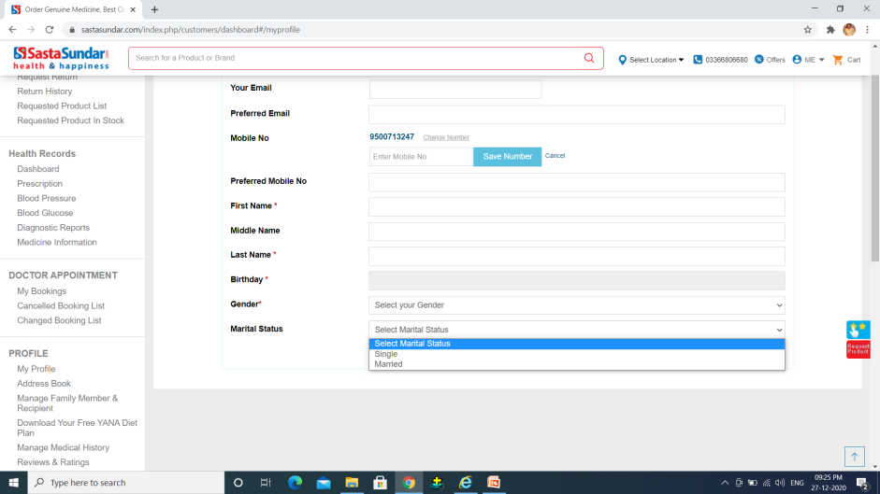
REPORT NO 17
1.ENTER THE URL IN DIFFERENT BROWSER LIKE CHROME,INTERNET EXPLORER
2.CLICK SASTA SUNDAR LINK IN BROWSER
3. IN HOME PAGE LOGIN AS USER A IN BOTH THE BROWSERS
4.CLICK MY PROFILE LINK
EXPECTED RESULT | ACTUAL RESULT | STATUS
IN MY PROFILE PAGE MARITAL STATUS OPTION SHOULD BE WORK IN BOTH THE BROWSER | IT NOT DISPLAY PROPERLY IN INTERNET EXPLORER BROWSER 1.IN CHROME BROWSER MY PROFILE PAGE MARITAL OPTION IS WORKED AND DROPDOWN WILL BE DISPLAY 2.IN INTERNET EXPLORER MY PROFILE MARITAL OPTION NOT WORK AND DROPDOWN IS NOT DISPLAY | FAIL
INTERNET EXPLORER
CHROME

Slide 19
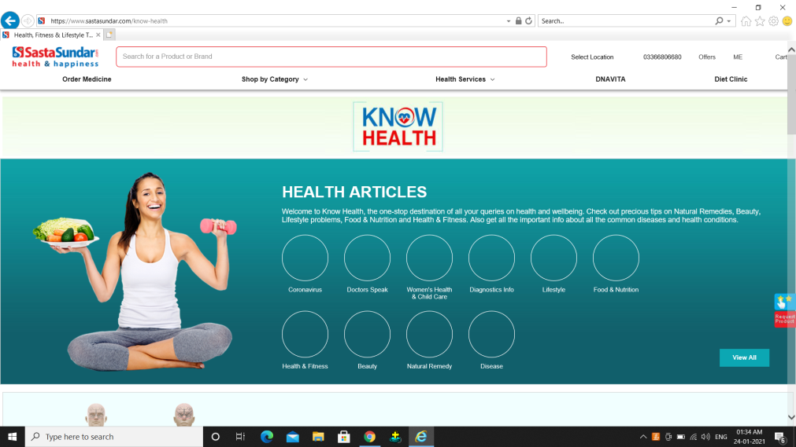
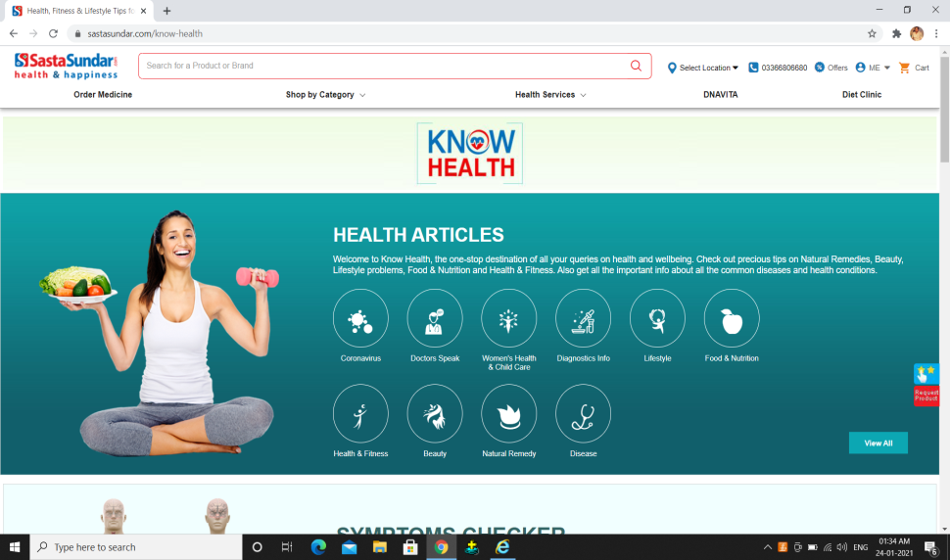
REPORT NO 18
1.ENTER THE URL IN DIFFERENT BROWSER LIKE CHROME,INTERNET EXPLORER
2.CLICK SASTA SUNDAR LINK IN BROWSER
3. IN HOME PAGE CLICK ON HEALTH SERVICE LINK IN BOTH THE BROWSERS
EXPECTED RESULT | ACTUAL RESULT | STATUS
HEALTH CHECK PAGE SHOULD BE DISPLAY PROPERLY IN BOTH THE BROWSER | IT NOT PROPERLY WORK IN INTERNET EXPLORER BROWSER 1.IN CHROME BROWSER HEALTH CHECK PAGE IS DISPLAY PROPERLY 2.IN INTERNET EXPLORER HEALTH CHECK PAGE IS NOT DISPLAY PROPERLY AND FEATURES ICONS ARE NOT DISPLAY | FAIL
INTERNET EXPLORER
CHROME

Slide 20

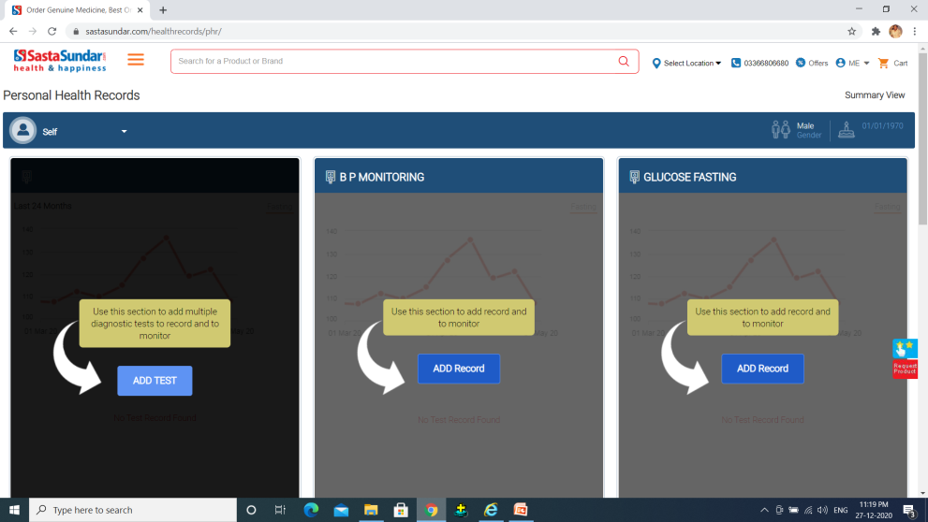
REPORT NO 19
1.ENTER THE URL IN DIFFERENT BROWSER LIKE CHROME,INTERNET EXPLORER
2.CLICK SASTA SUNDAR LINK IN BROWSER
3. IN HOME PAGE LOGIN AS USER A IN BOTH THE BROWSERS
4.GOTO MY PROFILE PAGE AND CLICK DASKBOARD LINK
EXPECTED RESULT | ACTUAL RESULT | STATUS
DASHBOARD PAGE SHOULD BE DISPLAY IN BOTH THE BROWSER | IT NOT PROPERLY WORK IN INTERNET EXPLORER BROWSER 1.IN CHROME BROWSER DASHBOARD IS WORKED AND IT WILL BE DISPLAY 2.IN INTERNET EXPLORER DASHBOARD IS NOT WORKING AND DASHBOARD PAGE IS NOT DISPLAY | FAIL
INTERNET EXPLORER
CHROME

Slide 21
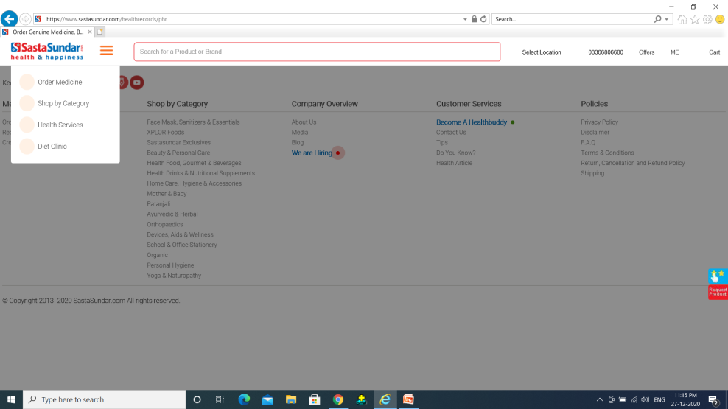
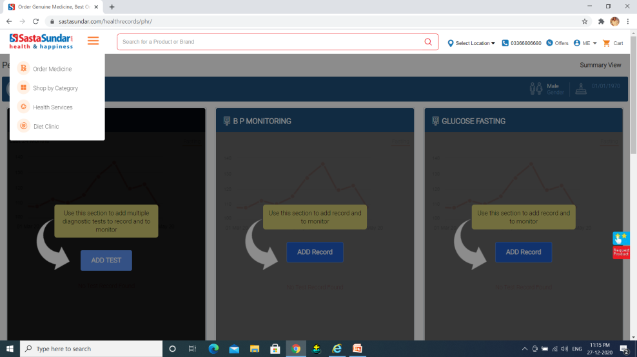
REPORT NO 20
1.ENTER THE URL IN DIFFERENT BROWSER LIKE CHROME,INTERNET EXPLORER
2.CLICK SASTA SUNDAR LINK IN BROWSER
3. IN HOME PAGE LOGIN AS USER A IN BOTH THE BROWSERS
4.GOTO MY PROFILE PAGE AND CLICK DASKBOARD LINK
EXPECTED RESULT | ACTUAL RESULT | STATUS
DASHBOARD PAGE IN MENU ICONS SHOULD BE DISPLAY IN BOTH THE BROWSER | IT NOT PROPERLY WORK IN INTERNET EXPLORER BROWSER 1.IN CHROME BROWSER DASHBOARD MENU ICONS WILL BE DISPLAY 2.IN INTERNET EXPLORER DASHBOARD IS NOT WORKING AND ICONS IS NOT DISPLAY | FAIL
INTERNET EXPLORER
CHROME

